Slide 1

Validate Configured Subscription YANG-Push Publisher Implementations NETCONF & NMOP WG
IETF 121
November 2-3rd, 2024
Hackathon

Slide 2
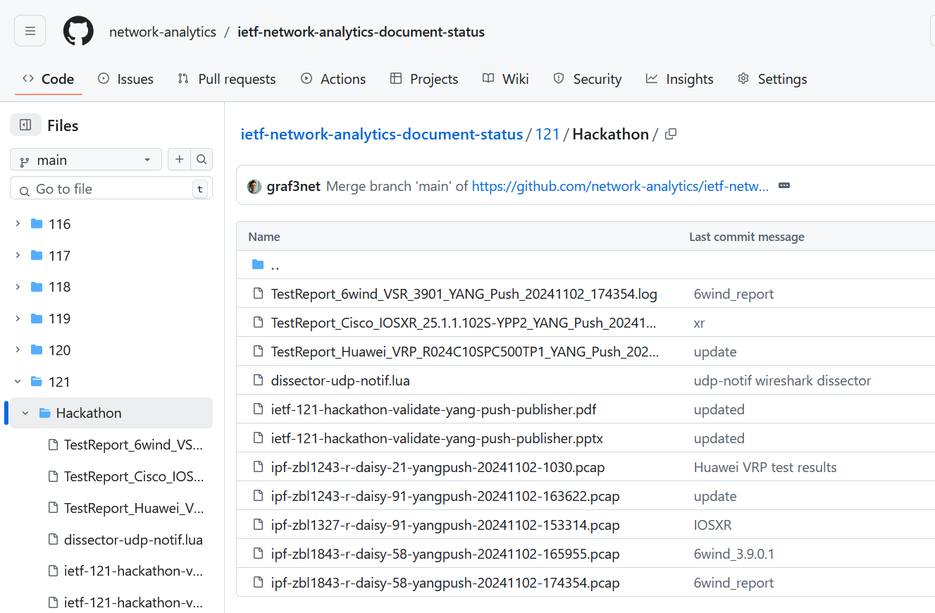
Hackathon – Repository
Test Repository
https://github.com/network-analytics/ietf-network-analytics-document-status/tree/main/121/Hackathon
Contains
Packet capture on the wire
Netconf RPCs and YANG-Push JSON messages
Python script which performed test cases

Slide 3

YANG-Push Implementation Status IETF 121 – MVP 1
 | 6WIND VSR | Huawei VRP | Cisco IOS XR | Open-Source
RFC 8639 YANG-Push Subscription | ✔ | P | P
RFC 8641 YANG-Push Notification | ✔ | P | ✔
draft-ietf-netconf-udp-notif | ✔ | ✔ | ✔ | ✔
draft-ietf-netconf-yang-notifications-versioning | ✔ | ✔ | ✔
draft-tgraf-netconf-notif-sequencing | ✔ | ✔ | ✔
draft-tgraf-netconf-yang-push-observation-time | ✔ | ✔ | ✔
RFC 7895 YANG Library |  | ✔
RFC 8525 YANG Library (NMDA) | ✔ |  | ✔
draft-ietf-netconf-yang-library-augmentation |  | P |  | ✔
RFC 9196 System and Notification Capabilities
draft-netana-netconf-notif-envelope
Green marked describes new capability at IETF 121. "P" to partially implemented.

Slide 4
YANG-Push Implementation Status IETF 121 – MVP 2
 | 6WIND VSR | Huawei VRP | Cisco IOS XR | Open-Source
draft-ietf-netconf-distributed-notif | ✔ | ✔
RFC 9254 CBOR
RFC 6347/RFC 9147 DTLS
Green marked describes new capability at IETF 121. "P" to partially implemented

Slide 5
YANG-Push Implementation Status IETF 121 – MVP 3
 | 6WIND VSR | Huawei VRP | Cisco IOS XR | Open-Source
RFC 8641 on-change subscriptions | ✔ | ✔ | P
draft-netana-netconf-yp-transport-capabilities
Green marked describes new capability at IETF 121. "P" to partially implemented

Slide 6
YANG-Push Standardization Progress at IETF 121 Suggest to Review
Relevant Presentations at Hackathon
slides-121-hackathon-sessd-validate-configured-subscription-yang-push-publisher-implementations-00.pdf
slides-121-hackathon-sessd-implement-find-relationship-solution-with-augmented-by-list-in-ietf-yang-library-00
Relevant Presentations at NMOP
slides-121-nmop-ietf-yang-push-implementations-and-next-steps-01
slides-121-nmop-an-architecture-for-yang-push-to-message-broker-integration-00.pdf
Relevant Presentations at NETCONF
slides-121-netconf-draft-ietf-netconf-udp-client-server-03-00.pdf
slides-121-netconf-draft-ietf-netconf-udp-notif-distributed-notif-00.pdf
slides-121-netconf-draft-ietf-netconf-yang-library-augmentedby-01-00.pdf
slides-121-netconf-draft-netana-netconf-notif-envelope-00-00.pdf
slides-121-netconf-yang-push-operational-data-observability-enhancements-00.pdf

Slide 7
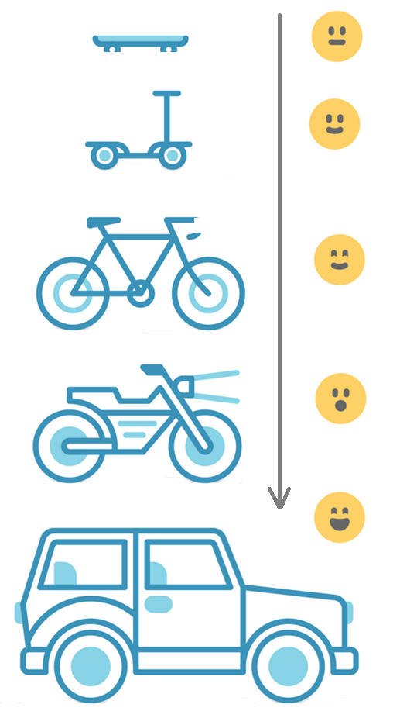
Address YANG Specification and Integration Gaps Aiming for an automated data processing pipeline
YANG Specifications Gaps:
Extensible YANG model for YANG-Push Notifications draft-netana-netconf-notif-envelope
YANG Notification Transport Capabilities draft-netana-netconf-yp-transport-capabilities
Validating anydata in YANG Library context draft-aelhassany-anydata-validation
YANG Integration Gaps:
Support of Network Observation Timestamping in YANG Notifications draft-tgraf-netconf-yang-push-observation-time
Support of Versioning in YANG Notifications Subscription draft-ietf-netconf-yang-notifications-versioning
Augmented-by Addition into the IETF-YANG-Library draft-ietf-netconf-yang-library-augmentation
YANG Simplification:
YANG-Push Operational Data Observability Enhancements draft-wilton-netconf-yp-observability

Slide 8
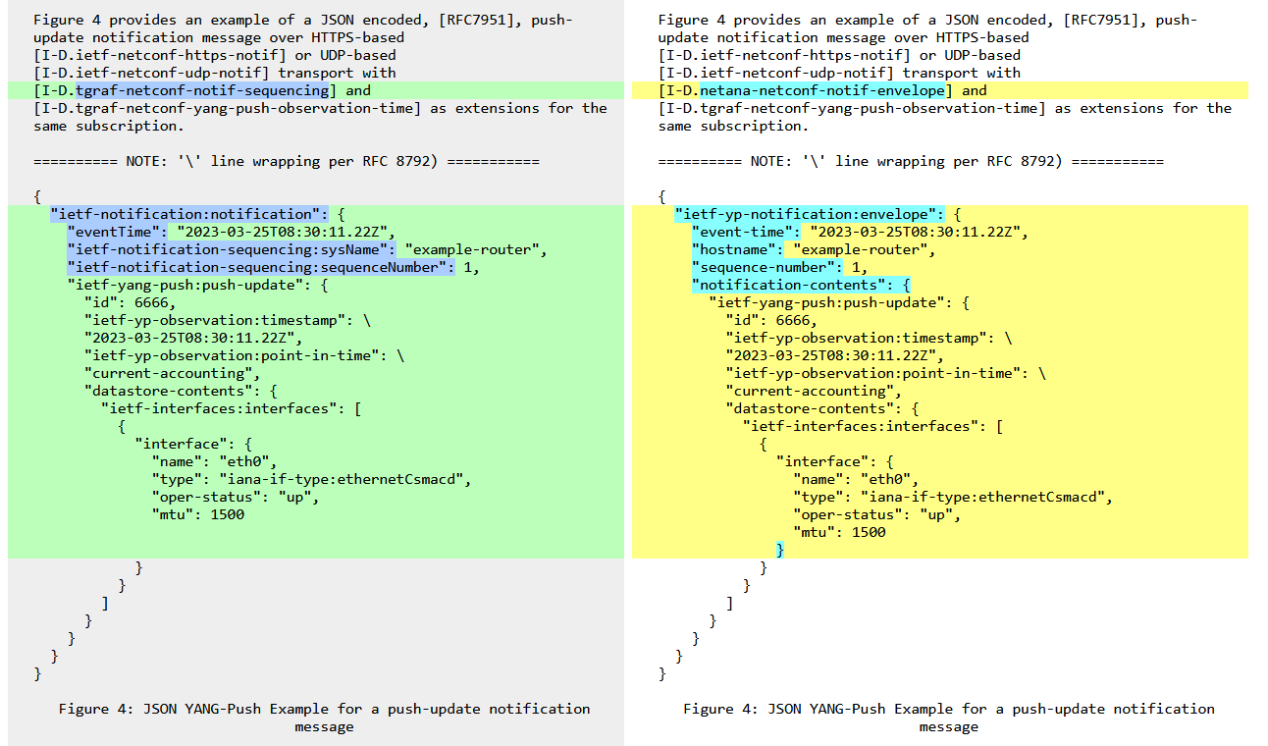
YANG-Push Specification changes at IETF 121 To be addressed in running code by IETF 122
Three new documents
draft-netana-netconf-notif-envelope
draft-netana-netconf-yp-transport-capabilities
draft-wilton-netconf-yp-observability
draft-netana-netconf-notif-envelope replaces draft-ahuang-netconf-notif-yang and draft-tgraf-netconf-notif-sequencing. Changes YANG module namespace and names for notification, sysName and sequencenumber.
https://author-tools.ietf.org/iddiff?url1=draft-ietf-nmop-yang-message-broker-integration-04&url2=draft-ietf-nmop-yang-message-broker-integration-05&difftype=--html

Slide 9
YANG-Push Standardization Progress at IETF 121 Planned activities by IETF 122
The following documents are going to be NETCONF working group last called
draft-ietf-netconf-udp-notif
draft-ietf-netconf-distributed-notif
draft-ietf-netconf-udp-client-server
The following document is going to be NETCONF working group adopt called
draft-netana-netconf-notif-envelope
The following document is going to be scoped, refined and discussed within a group of implementors and operators (Huawei xxx, Cisco Rob Wilton, Juniper Ebben Aries, Nokia James Cummings, Swisscom Thomas Graf, Bell Canada Daniel Voyer, Deutsche Telekom Holger Keller, NTT Paolo Lucente)
draft-wilton-netconf-yp-observability
The following documents are discussed on the NETCONF mailing list
draft-netana-netconf-yp-transport-capabilities
draft-tgraf-netconf-yang-push-observation-time
draft-ietf-netconf-yang-notifications-versioning
draft-ietf-netconf-yang-library-augmentation

Slide 10
YANG Notification Transport Capabilities Extending System Capabilities for YANG-Push Configured Subscription Transport
module: ietf-notification-transport-capabilities
augment /sysc:system-capabilities/notc:subscription-capabilities:
+--ro transport-capabilities
+--ro transport-capability* [transport-protocol]
+--ro transport-protocol identityref
+--ro security-protocol? identityref
+--ro encoding-format* identityref
augment "/sysc:system-capabilities/notc:subscription-capabilities" {
description "Add system level capability.";
container transport-capabilities {
description "Capabilities related to YANG-Push transports.";
list transport-capability {
key "transport-protocol";
description "Capability list related to notification transport capabilities.";
leaf transport-protocol {
type identityref {
base sn:transport;
}
description "Supported transport protocol for YANG-Push.";
}
leaf security-protocol {
type identityref {
base security-protocol;
}
description "Type of secure transport.";
}
leaf-list encoding-format {
type identityref {
base sn:encoding;
}
description "Supported encoding formats.";
}
}
}
draft-netana-netconf-yp-transport-capabilities augments System Capabilities model and provides additional transport related attributes associated with system capabilities:
Specification of transport protocols the client can request to establish a draft-ietf-netconf-udp-notif or draft-ietf-netconf-https-notif configured transport connection;
Specification of transport encoding, such as JSON or XML as defined in RFC 8040 or CBOR as defined in RFC 9254 the client can request to encode YANG notifications;
Specification of secure transport mechanisms that are needed by the client to communicate with the server such as DTLS as defined in RFC 9147 TLS as defined in RFC 8446 or SSH as defined in RFC 4254;

Slide 11
Extensible YANG model for YANG-Push Notifications For XML, JSON or CBOR encoded messages with hostname and sequence-number
notifications:
+---n envelope
+--ro event-time yang:date-and-time
+--ro hostname? inet:host
| {notification-hostname-sequence-number}?
+--ro sequence-number? yang:counter32
| {notification-hostname-sequence-number}?
+--ro notification-contents? <anydata>
draft-netana-netconf-notif-envelope defines new extensible notification structure, defined in YANG, for use in YANG-Push Notification messages enabling any YANG compatible encodings such as XML RFC 7950, JSON RFC 7951 or CBOR RFC 9264.
New notification envelope can be enabled in "ietf-subscribed-notification" RFC 8639.
Capability can be discovered through 'ietf-notification-capabilities' RFC 9196.
Supports the following notification metadata extensions
hostname: Describes the node's hostname according to the 'sysName' object definition in RFC 1213 from where the message was published from. This value is usually configured on the node by the administrator to uniquely identify the node in the network.
sequence-number: Generates a unique sequence number for each published message by the publisher process. The number counts up at every published notification message as described in RFC 9187.
{
"ietf-yp-notification:envelope": {
"event-time": "2023-03-25T08:30:11.22Z",
"hostname": "example-router",
"sequence-number": 1,
"notification-contents": {
"ietf-yang-push:push-update": {
"id": 6666,
"datastore-contents": {
"ietf-interfaces:interfaces": [
{
"interface": {
"name": "eth0",
"type": "iana-if-type:ethernetCsmacd",
"oper-status": "up",
"mtu": 1500
}
}
]
}
}
}
}
}

Slide 12
YANG-Push Operational Data Observability Enhancements Simplifies by combining periodic and on-change subscription
module: ietf-yp-ext
augment /sn:subscription-started/yp:update-trigger:
+--:(periodic-and-on-change) {yp:on-change}?
+-- periodic-and-on-change!
+-- period yp:centiseconds
+-- anchor-time? yang:date-and-time
+-- dampening-period? yp:centiseconds
+-- sync-on-start? boolean
+-- excluded-change* yp:change-type
augment /sn:subscription-started:
+--ro common-notification-format? boolean
augment /sn:subscription-modified/yp:update-trigger:
+--:(periodic-and-on-change) {yp:on-change}?
+-- periodic-and-on-change!
+-- period yp:centiseconds
+-- anchor-time? yang:date-and-time
+-- dampening-period? yp:centiseconds
+-- sync-on-start? boolean
+-- excluded-change* yp:change-type
augment /sn:subscription-modified:
+--ro common-notification-format? boolean
augment /sn:subscriptions/sn:subscription/yp:update-trigger:
+--:(periodic-and-on-change) {yp:on-change}?
+--rw periodic-and-on-change!
+--rw period yp:centiseconds
+--rw anchor-time? yang:date-and-time
+--rw dampening-period? yp:centiseconds
+--rw sync-on-start? boolean
+--rw excluded-change* yp:change-type
augment /sn:subscriptions/sn:subscription:
+--rw common-notification-format? boolean
To reduce complexities in modelling the operational state, the following two YANG-Push enhancements are proposed:
A new YANG-Push encoding format that can be used for both on-change and periodic subscriptions that reports the data from the subscription filter point.
A combined periodic and on-change subscription that reports events on a periodical cadence and also if changes to the data have occurred.
This removes the YANG Patch format RFC 8072 dependency and eases the message broker integration.
Allows the YANG-Push publisher to split a subscription into smaller child subscriptions for more efficient independent and concurrent processing. Reuses the ideas from draft-ietf-netconf-distributed-notif. Child subscriptions remain encoded from the same subscription point.
notifications:
+---n update
+--ro id? sn:subscription-id
+--ro subscription-path? yang:xpath1.0
+--ro target-path? string
+--ro snapshot-type? enumeration
+--ro observation-time? yang:date-and-time
+--ro datastore-snapshot? <anydata>
+--ro incomplete? empty

Slide 13
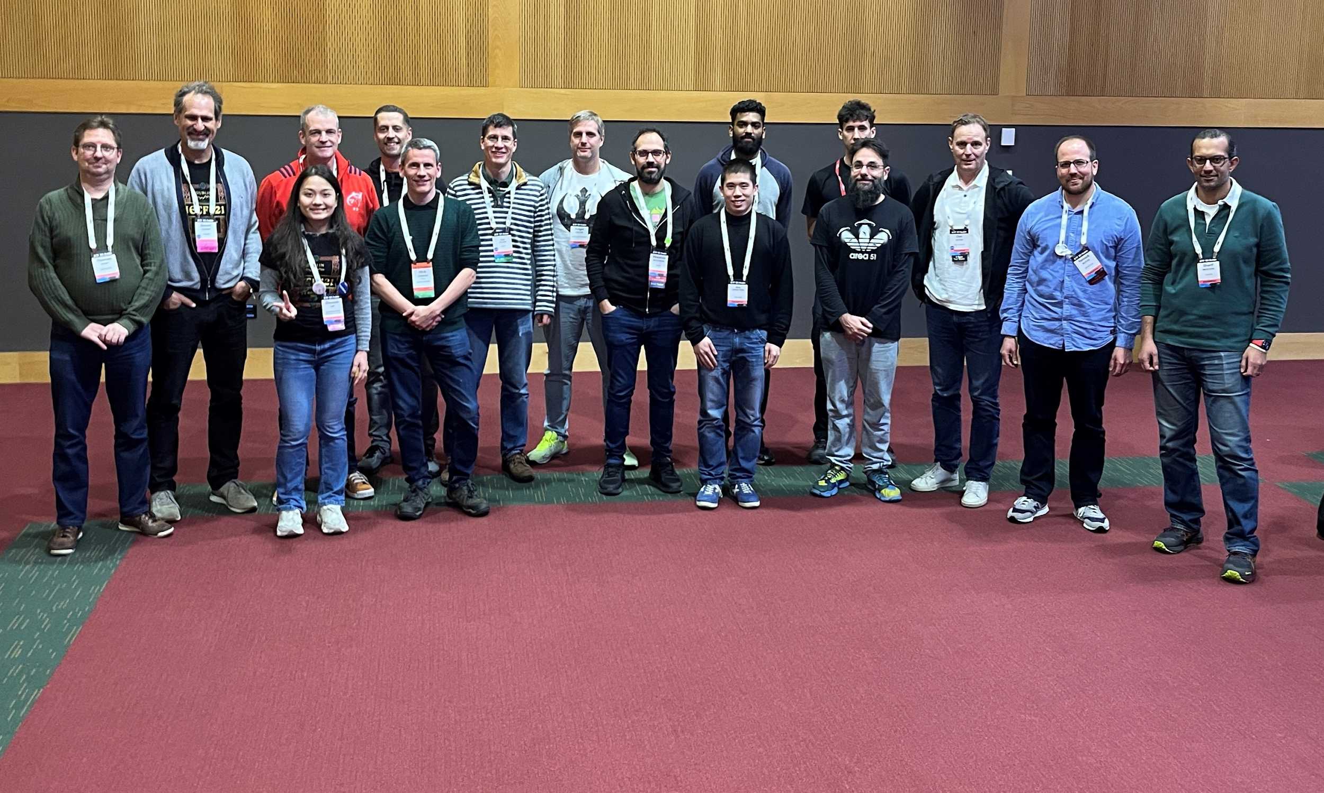
Thanks to…
Rob Wilton – Cisco
Nick Corran - Cisco
Emma Rankin – Cisco (remote)
Mathew Green – Cisco (remote)
Samuel Gauthier – 6WIND (remote)
Jérémie Leska – 6WIND (remote)
Liu Bin – Huawei (remote)
Benoit Claise – Huawei
Zhuoyao Lin - Huawei
Ebben Aries – Juniper
James Cummings - Nokia
Paolo Lucente – Pmacct
Holger Keller – DT
Daniel Voyer – Bell Canada
Alex Huang-Feng – INSA Lyon
Yannick Buchs – Swisscom
Thomas Graf – Swisscom
Ahmed Elhassany – Swisscom (remote)
Uwe Storbeck – Swisscom (remote)

